Slide 1
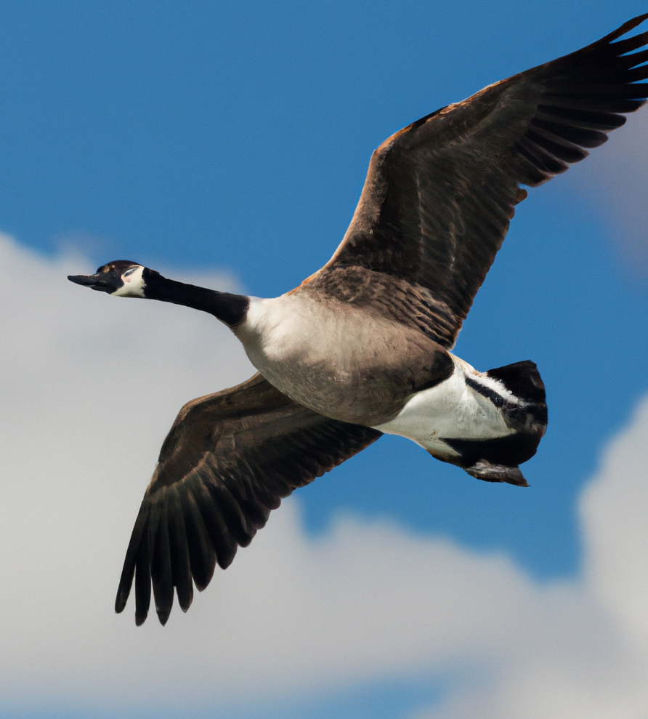
Classification of Bird Species based on EfficientNet architecture
Supervisor: Senior Lecturer Ramil Shukurov
Presenter: Bahruz Huseynov

Slide 2
Bird encyclopedia infographics
01
Introduction
02
Data
03
Architecture
04
Discussion of Results

Slide 3
How to differentiate the species
Bill
Feet
Wing
Tail
Size
Eyes

Slide 4




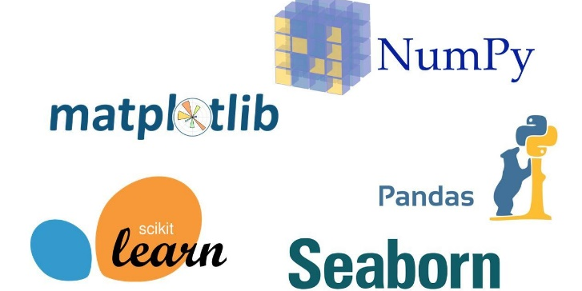
Used Tools
PyTorch is a Machine and Deep Learning Python framework.
Google Colaboratory environment.
The dataset taken from Kaggle contains 11 788 images with 200 classes, approximately 50-60 images per class.
Other python libraries for different purposes.

Slide 5
02
Data

Slide 6
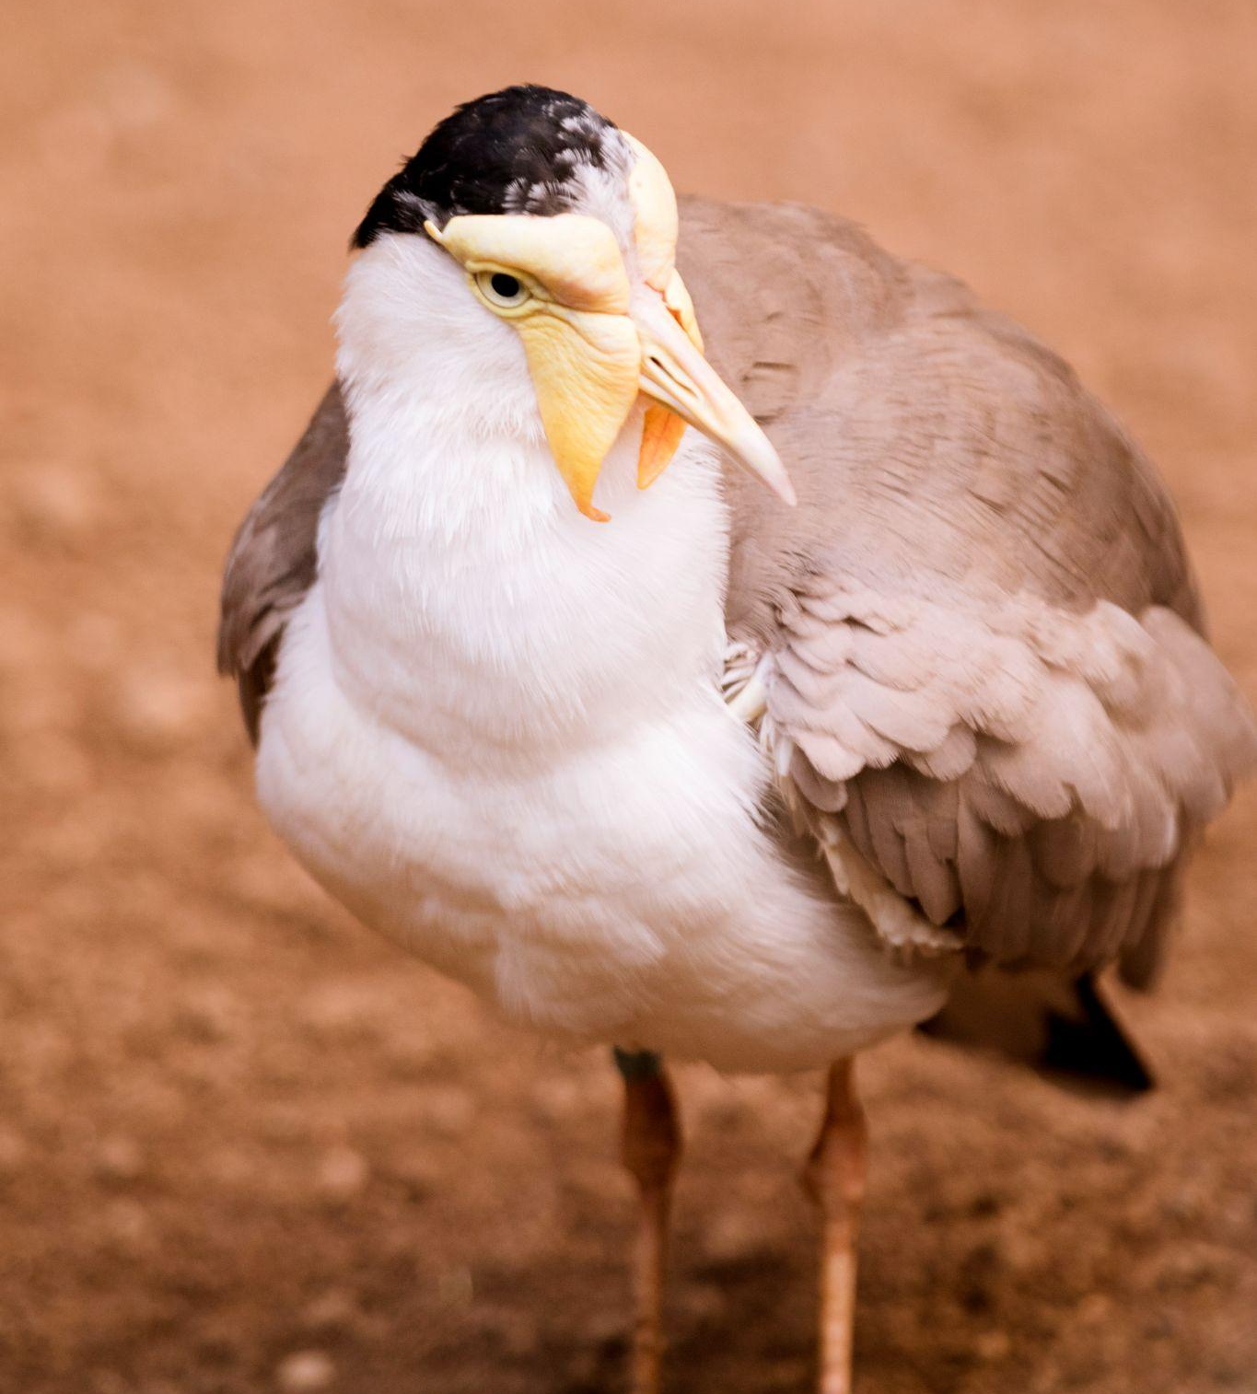
Dataset | Details
Dataset 1.1 | Original images with 200 labels
Dataset 1.2 | Cropped pixels of the birds based on their position in the images. Cropping has been done with the help of segmented pictures available in the original dataset.
Dataset 2 | Alternative to the main dataset due to low quality
Main dataset:
11 788 bird images
200 labels
Each consists of 50-60 images
Bird images with different shapes (500x500, 200x200), positions (flying, swimming) and quality
The second dataset:
3324 bird images
20 labels
All images have the static shape of 224x224
Regular quality

Slide 7
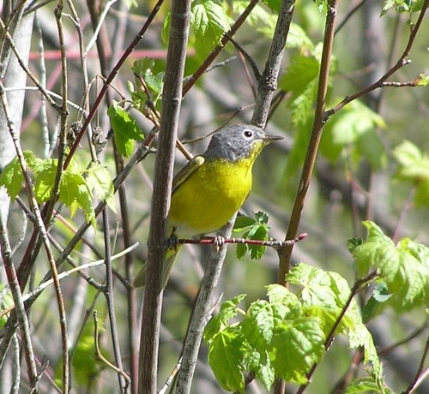
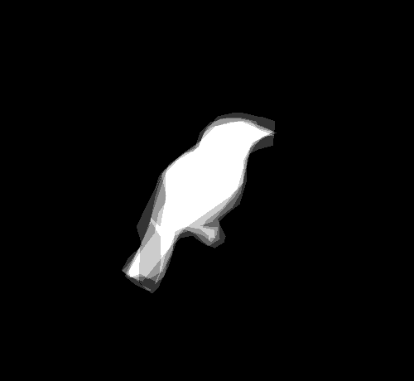
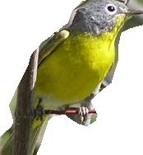
500x460
500x460
174x188
Dataset 1.2

Slide 8
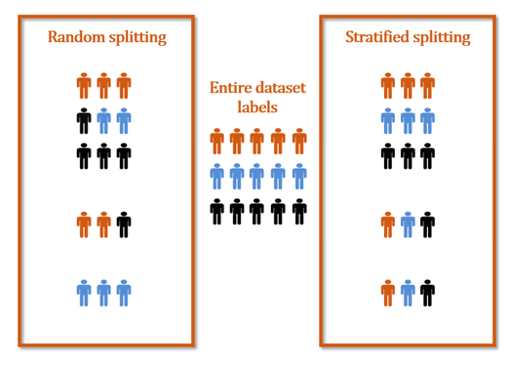
Training - 80%
Validation - 10%
Testing - 10%
Data splitting

Slide 9
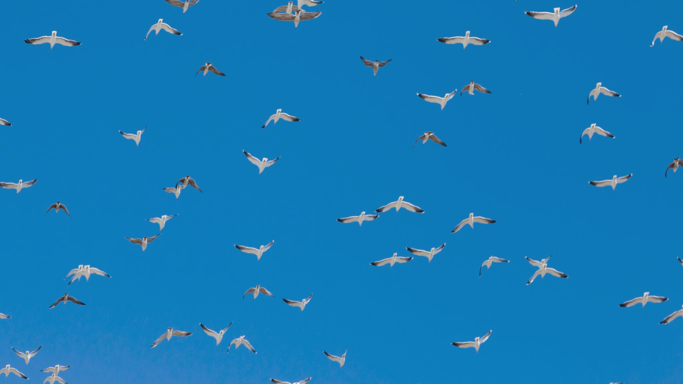

03
Methodology

Slide 10
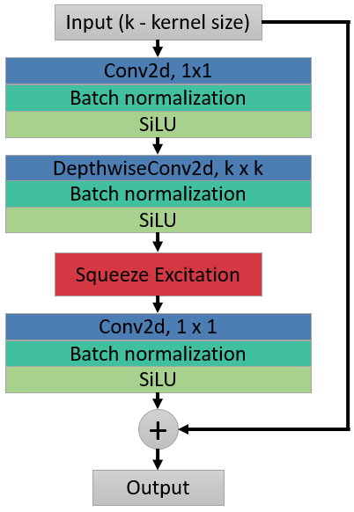
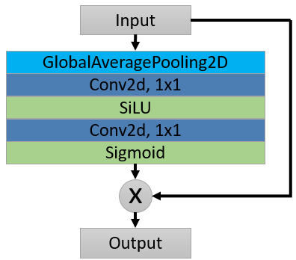
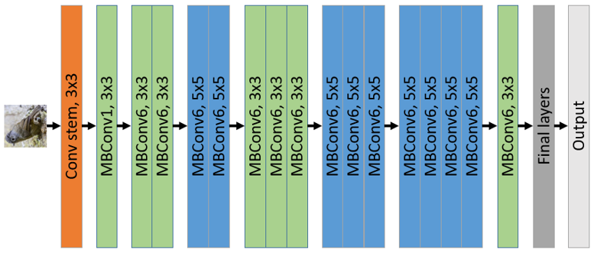
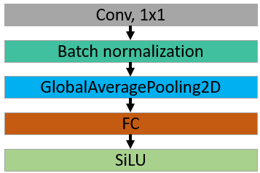
Squeeze and Excitation
MBConv block
Final Layers
EfficientNet-B0 architecture

Slide 11
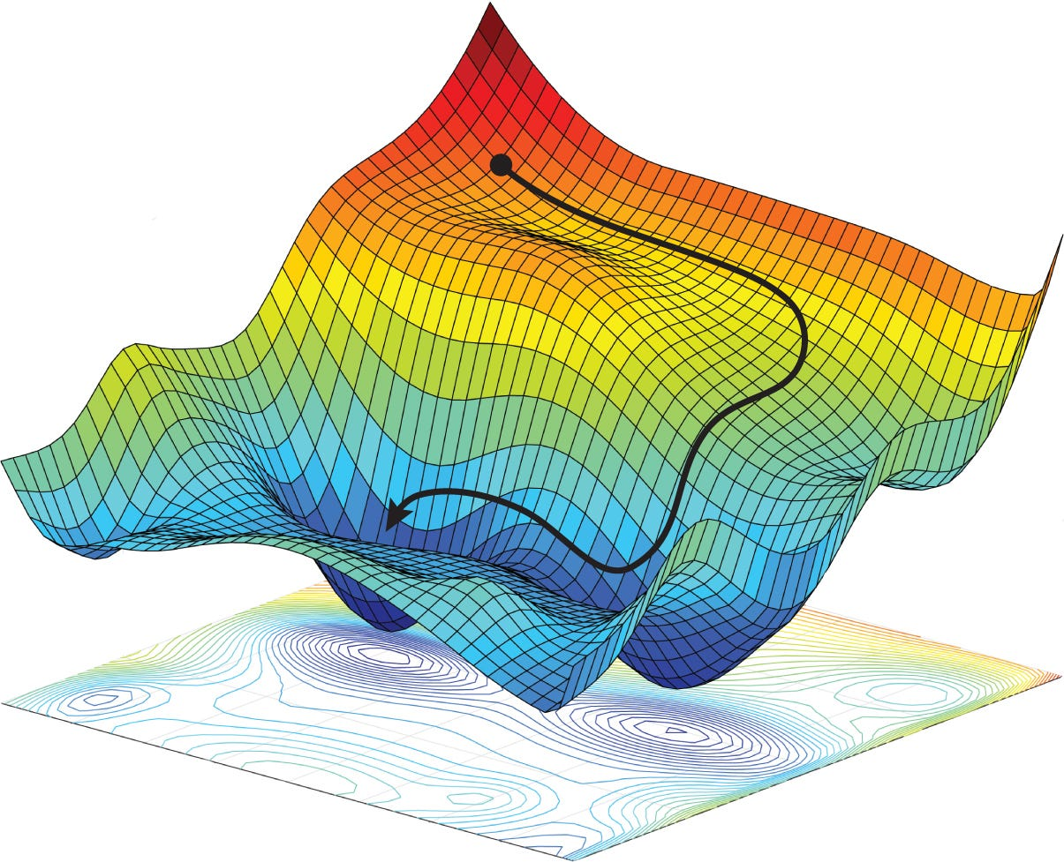
Optimizers
and Loss functions
Optimizers
- SGD with momentum
- Adam
Loss
- Cross Entropy Loss
Intuitional optimization

Slide 12
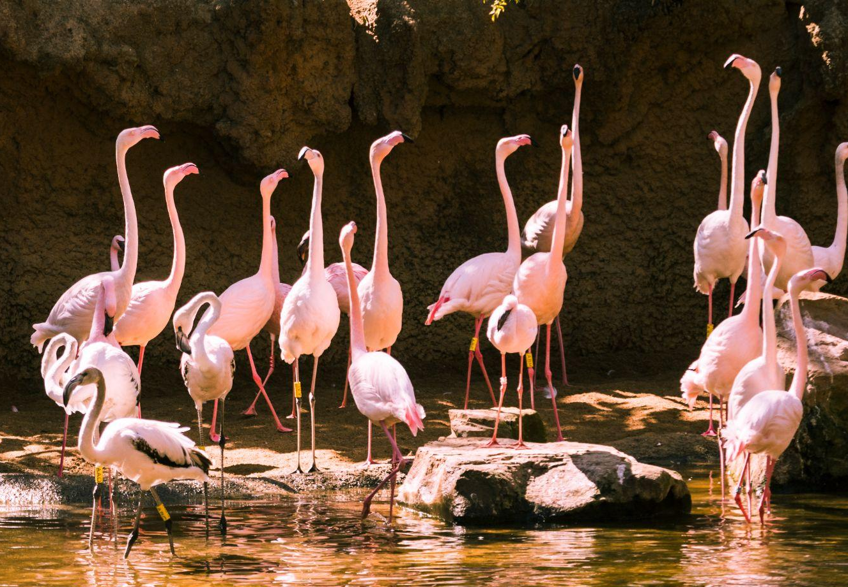
04 |
Results

Slide 13
^{[1]} Step scheduler is used to adjust the training process by reducing the learning rate after specific number of epochs
EfficientNet Family | Dataset | Number of epochs | Learning rate | Test accuracy
B0 (scratch) | Dataset 1.1 | 50 | 0.1 | 35.36%
B0 (scratch) | Dataset 1.2 | 40 | 0.1 | 50.97%
B0 (Fine-tuning) | Dataset 1.1 | 20 | 0.1 (Step scheduler) | 76.96%
B0 (Fine-tuning) | Dataset 1.2 | 15 | 0.1 (Step scheduler) | 83.8%
B1 (Fine-tuning) | Dataset 1.1 | 15 | 0.1 (Step scheduler) | 78.48%
B1 (Fine-tuning) | Dataset 1.2 | 15 | 0.1 (Step scheduler) | 84.64%
Results of the practical application of architecture on the main dataset are shown in the table above. In the experiment, the batch size was 32 and SGD with Momentum was used as an optimizer.
Main Dataset

Slide 14
Fine-tuned EfficientNet-B1 (84.64%) training procedure

Slide 15
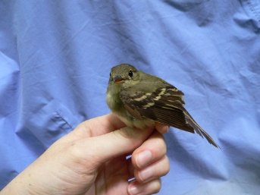
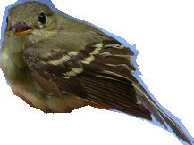
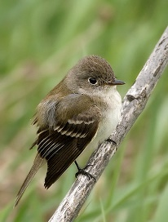
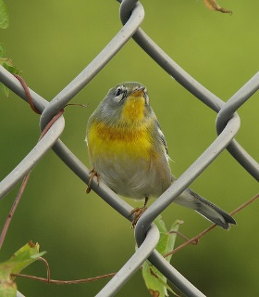
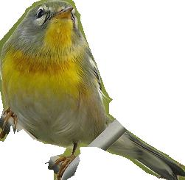
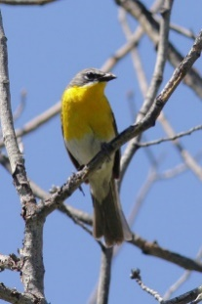
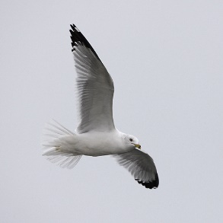
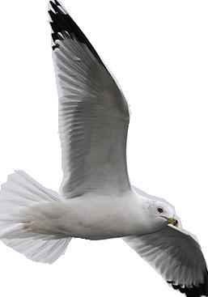
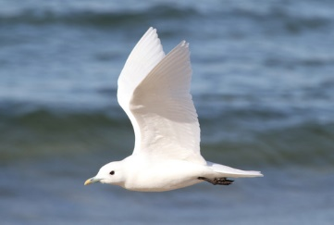
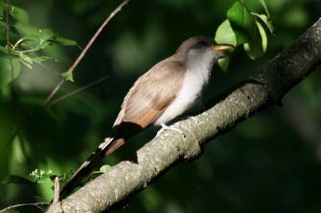
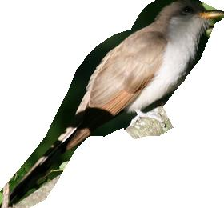
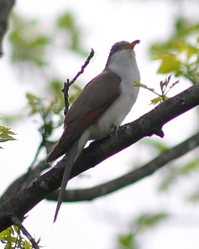
Original image | Cropped image | Actual class (Label) | Predicted class (Label) | Predicted class sample image
 |  | Acadian Flycatcher (37) | Least Flycatcher (39)
 |  | Yellow-bellied Flycatcher (43) | Yellow-breasted Chat (20)
 |  | Ring-billed Gull (64) | Ivory Gull (63)
 |  | Black-billed Cuckoo (31) | Yellow-billed Cuckoo (33)

Slide 16
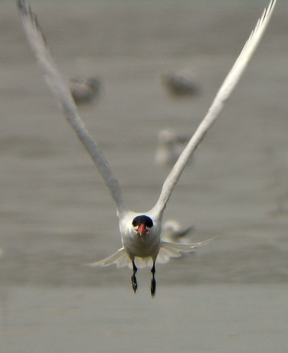
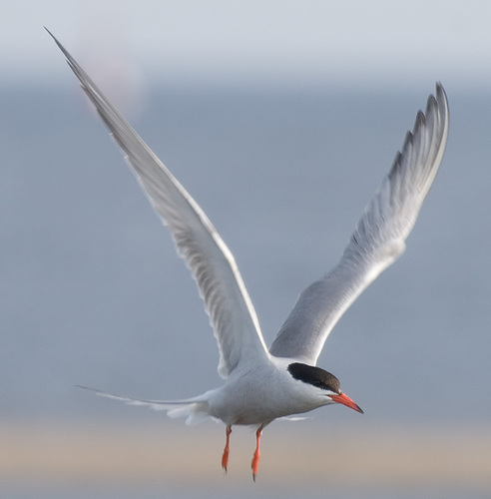
White – (Upper parts) – Grayish
Red-orange – (Bill) – Red-black
Black – (Feet) – Reddish
Differences that can not be seen:
Size – Caspian terns are generally larger than common terns.
Tail – Caspian terns have a deeply forked tail with long outer tail feathers.

Slide 17
Class | Precision | Recall | F1-score
Brewer Blackbird | 0.4 | 0.33 | 0.36
Brandt Cormorant | 0.57 | 0.67 | 0.62
Shiny Cowbird | 0.4 | 0.33 | 0.36
American Crow | 0.4 | 0.67 | 0.5
California Gull | 0.25 | 0.17 | 0.2
Long tailed Jaeger | 0.44 | 0.67 | 0.62
Common Tern | 0.33 | 0.33 | 0.33
Forsters Tern | 0.38 | 0.5 | 0.43
Classification Report (Worst predictions)

Slide 18
EfficientNet Architecture | Number of epochs | Learning rate | Optimizer | Test accuracy
B0 (scratch) | 30 | 0.005 | SGD (Momentum) | 77.31%
 |  | 0.001 | Adam | 74.33%
B1 (scratch) | 30 | 0.005 | SGD (Momentum) | 76.49%
B0 (Pre-trained) | 13 | 0.1 (Step scheduler) | SGD (Momentum) | 95.24%
 |  |  | Adam | 95.83%
B1 (Pre-trained) | 13 | 0.1 (Step scheduler) | SGD (Momentum) | 93.45%
Practical results of the models on the second dataset (Batch size was 16)
The second dataset

Slide 19
EfficientNet-B0 built from scratch (SGD with Momentum optimizer) training procedure

Slide 20
Conclusions
Conclusion 1
Conclusion 3
The low quality and various shapes of images in the main dataset can be considered the reason for the less test accuracy.
The model comes across problems to differentiate the subspecies from others.
Conclusion 2
Conclusion 4
The number of classes in modelling can affect the result as a model has more challenges to predict a specific label among all.
EfficientNet is effective architecture for the classification of bird images but it depends on several factors (the number of classes, types of images, hyperparameters and others)

Slide 21

Thank you!

